Slide 1



Citrus leaves
Doanh Pham, Naser Zaghwan, Ibrahima Doumbia
Team 2 Major
School of Technology & Computing (STC)

Slide 2
Agenda
Abstract
Keywords
Introduction
Literature Review
Data Selection
Issues Found
Tools Used
Model Summary
Model evaluation
Hyperparameter Selection
Conclusion
GitHub Address
Key References

Slide 3
Abstract
The task of quickly recognizing the quality of leaves in the agricultural fields poses a row of information technologies to support agriculture production and provide better institutional research. Today, the most common way of overcoming these challenges is by the use of machine learning applications, which is a sub-field of artificial intelligence. Over the past years, machine learning has assisted enormously research center in the classification of leaves. Thus, when it comes to the identification of leaf quality, it is better that research centers and students become more familiar with the recent advances in machine learning technologies and get engaged in their development. In the paper, we will utilize a given online dataset, in coordination with machine learning methods, to precisely automate a system with the least loss achievable that will aid in categorizing and determining whether the given leaves are good or bad to prevent the error of human being.

Slide 4

Keywords
Data Collection, dataset, Image Augmentation, Training Set, Validation Set, Convolutional Neural Network, Optimizer

Slide 5
Introduction
On the whole, it might be the case that the quality of leaves could be another significant process to be determined. Manually checking the state and presence of leaves by simply looking at them can be time consuming and prone to error. This project aims to develop an automated method of carrying out the activities of categorizing the quality of the leaves as good or bad using machine learning with the assistance of the power of Convolutional Neural Networks (CNNs), as a priority. This method can assist in detecting the healthy leaves of the plants by identifying the good ones correctly. In a sense, through the use of Convolutional Neural Networks (CNNs), Artificial Intelligence is justified in solving the problem for several reasons. Such as mitigating human error, leveraging visual data effectively, addressing inefficiency of manual inspection and data-driving decision making. So, in essence AI offers a robust, efficient and accurate solution which makes it highly advantageous.

Slide 6
Literature Review1
The critical importance of plant health in agriculture and ecological studies necessitates accurate and efficient methods for assessing the citrus leaf quality in our case. As identified that traditional manual inspection methods consume time and prone to error and mistakes, that bring about the need for automated solutions. Therefore, we will delve into the historical context of how the problem/solution has evolved over time, how Convolutional Neural Networks (CNN) works, and discuss the challenges in implementing these solutions for the citrus leaf categorization. Well, for centuries farmers and botanists only relied on visual inspection and some experts’ knowledge to identify diseases in leaves, of course that came with limitation in human perceptions and problems were identified after significant damage had occurred. So, in the early 21st century with the advent of computing, researchers began to explore how to classify image processing techniques for leaves disease detection. Even though there were some improvements over manual inspection, they were still struggling with symptoms of various diseases.

Slide 7
Literature Review2
Then, from 2000s to now, the adoption of machine learning brought about more sophisticated algorithms for leaves disease detection and neural networks started to be applied. Then, in 2012 to now, the paradigm changed with the rise of deep learning particularly Convolutional Neural Networks (CNNs). However, Neural Networks (NNs) are inspired by the structure and function of human brain and they consist of interconnected nodes(neurons) organized in layers which learn patterns from data in dataset provided. So, Convolutional Neural Networks (CNNs) consist of Convolution layers, activation functions (ReLU), Pooling layers (Max Pooling), Flatten layer. Despite the power of CNNs, there are challenges encountered in developing robust and accurate automated citrus leaf quality categorization system. For instance, during data acquisition and annotation where we can have manually labeling thousands of images as “good” or “bad” and datasets can suffer from class imbalance. Also, the emergence of new diseases issues not present in the training data poses a challenge for a model robustness.

Slide 8
Data Selection
For this specific case, we used citrus fruits dataset; citrus leaves dataset for detection and classification of citrus diseases through Machine Learning via Convolutional Neural Networks (CNNs). The reason why we chose this data is, to create a robust citrus leaves disease detection system model that can automate and categorize whether a citrus leaf is “good” or “bad” that was previously done manually. Also, to support citrus leaves classification research with this robust system to push researchers to create sophisticated algorithms that can differentiate between them accurately and enable transfer learning capacity to generation to come. We surely know that despite the benefits of this robust and accurate system, training model on citrus dataset can come with limitations; such as imbalanced dataset; overfitting; lack of diversity or containing images with low resolution and diseases that are specific to certain regions, poor labeling or annotations and training such data can lead to poor model robustness.

Slide 9
Issues Found
Inequal image quality: some images will have some unequal image resolution and brightness or a background.
Class imbalance: There are potential imbalanced population of images of a few types of disease occurrences (Black Spot, Canker, Greening, Healthy).
Duplicate images: On-line data sets are normally encircled by likeness or near likeness images.
Red noise in dataset: Dataset may contain irrelevant or mis labeled images in the dataset.
Pixel value range: CNN training involves that pixel values must be normalized between 0-255

Slide 10
Tools Used
NumPy and Pandas: to process the data and examine the metadata.
OpenCV / PIL - utilized to open an image, image size, and clean image.
Image preprocessing TensorFlow/Keras preprocessing ImageDataGenerator: Image According to augmentation and normalization.
Matplotlib / Seaborn - to visualize the distribution of classes.

Slide 11
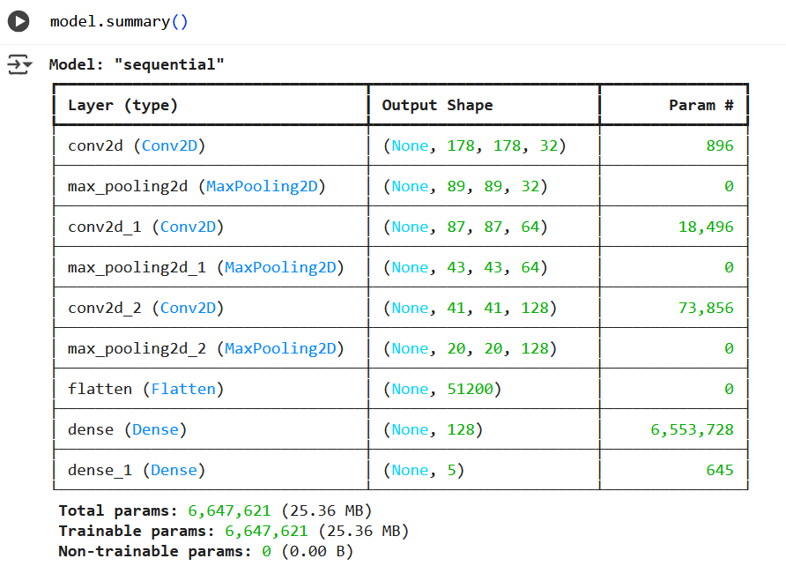
Model Summary

Slide 12
Model evaluation
After the development of the Convolutional
Neural Network (CNN), the next stage involved testing its performance to make sure it can correctly classify the citrus leaves as healthy or diseased. This stage was used to understand the strengths and limitations of our model in order to make required changes for better generalization.

Slide 13
Hyperparameter Selection
In the initial model definition, hyperparameters are selected manually:
Conv2Dfilters and kernel sizes: The first Conv2D layer uses 32 filters with a 3×3 kernel, the second 64 filters with 3×3, and the third 128 filters with 3×3. These are fixed choices.
Dense units: The dense layer has 128 units.
Optimizer and Learning Rate: Adam optimizer is used with its default learning rate.
Epochs: The model is trained for 15 epochs.
However, the code then introduces Kera Tuner for automated hyperparameter selection. This is a significant improvement: This process demonstrates a robust approach to hyperparameter selection, moving from manual guesses to an automated search.

Slide 14
Conclusion
The purpose of this project is to capitalize on the capability of Convolutional Neural Networks to assist with: automated leaf quality classifications. As we fold a more accurate and stronger model, we isolate ourselves in order to contribute more productive and accountable resources to future current and researchers through the magic of machine learning among others. We developed and optimized a Convolutional Neural Network (CNN) for classifying citrus leaf diseases. Which required downloading and preparing a dataset of citrus leaf images, followed by building, training, and evaluating a CNN model. However, the use of Kera Tuner for automated hyperparameter tuning, which systematically searches for the best combination of architectural and training parameters to maximize validation accuracy. So, our model employs standard image preprocessing and performance optimization techniques. Finally, goal is to create a robust and accurate AI application capable of identifying different citrus leaf conditions.

Slide 15
GitHub Address
https://github.com/Doumex01/TP04---Final-Presentation

Slide 16
Key References
Ahmed AA, Reddy GH (2021) A mobile-based system for detecting plant leaf diseases using deep learning. AgriEngineering 3(3):478–493.
https://doi.org/10.3390/agriengineering3030032
Bhargava, A. Y. (2016). Grokking algorithms: An illustrated guide for programmers and other curious people. Manning Publications.
Yao, J., Tran, S. N., Sawyer, S., & Garg, S. (2023, October 18). Machine Learning for Leaf Disease Classification: Data, techniques and Applications - Artificial Intelligence Review. SpringerLink.
https://link.springer.com/article/10.1007/s10462-023-10610-4

Slide 17


Thank You

